Slide 1

Overcoming Adversity:
Lessons in Resiliency and the Cost of Delayed Care
Lisa Fitzpatrick, DrOT | CEO, XcelABLE
Author of *Can Someone Help Me?*

Slide 2


My Story of Overcoming Adversity..
Rising Above, Stronger Than Before.

Slide 3
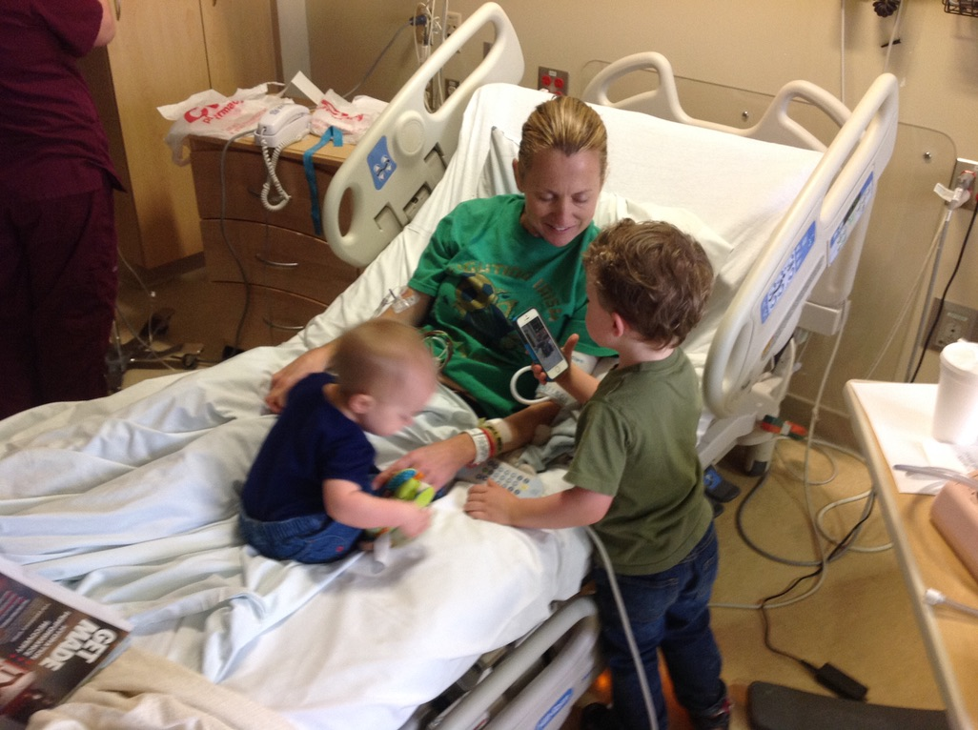
Suspended between fear and hope, not knowing which would claim me

Slide 4

The Fear of the Unknown
Loss of Control
Will I recover? Will I work again? How will I support my family?
Emotional Spiral
Not knowing is sometimes scarier than the pain itself.
Medical Consequences of Fear
Fear of the unknown becomes a medical barrier in itself.
Financial & Family Impact
“Can I provide for my kids? Will I lose my job? Will my coworkers see me as weak?” compound suffering.

Slide 5

While the system delays, the suffering doesn’t…
Delays don’t pause their suffering — they often compound it with secondary injuries, mental health struggles, and loss of hope.
“Behind every claim number is a human being who is hurting — and their suffering does not wait for the paperwork to catch up.”

Slide 6
System Delays Multiply Fear
Every unanswered call, every unapproved referral, every denied treatment feeds uncertainty.
Workers begin to catastrophize: “Maybe they think I’m faking. Maybe I’ll never get better.”

Slide 7

The vicious circle
Fear turns into mistrust, and mistrust drives conflict, litigation, and disengagement.

Slide 8

How can we break this cycle?
Holistic care beyond the injury
Improved communication and transparency
Empowerment and Return-To-Work Support

Slide 9
Holistic Care Beyond the Injury
Integrate mental health support
Encourage support from the entire medical team
Provide education to alleviate fears and set realistic expectations.

Slide 10
Improved Communication and Transparency
As medical professionals, we need to explain more in plain language about the treatment plan and recovery timeline
Insurace companies can be proactive on updating the workers on approvals, benefits, and next steps.
Both should listen the employee. Take proactive steps to help with the treatment planning in understanding the employee.

Slide 11

Empowerment and Return-To-Work Support
A cookie cutter approach does not work for anyone.
Provide proactive training –resilence training, coping strategies for dealing with challeges
Encourage support with others who have similar issues so they do not feel alone.

Slide 12
Interactive Reflection
I want you all to pause for a moment for 2-3 mins. Think about a moment where you had an employee who was injured and if you implemented these strategies, how the outcome may have been different?
Or think about a time, when you did implement some of these strategies and the outcome was different.
Take 1–2 minutes to reflect or share.

Slide 13
Early Treatment Intervention
Speed
Coordination
Emotional support
Communication

Slide 14
Prevention Shifts Culture from Reactive to Proactive
Traditional model: Wait until injury occurs → treat → attempt return-to-work.
Preventive model: Identify risks early → apply ergonomic, physical, and mental health interventions → sustain well-being.
Global best practice: Japan’s “karoshi” (death from overwork) crisis led to early stress monitoring and wellness laws, showing how prevention can reshape workplace culture and policy.

Slide 15
Prevention Builds a Healthier, More Resilient Workforce
Early screening tools (like POET, WAI, GAD-7, BRS) catch risks before they develop into injuries or chronic problems.
Mental health integration: Addressing psychosocial risks globally (stress, anxiety, burnout) prevents both errors and physical strain.
Result: Workers feel supported, recover faster, and are more engaged in their roles.

Slide 16
Prevention Framework
Before hire → POET ensures safe job placement.
During employment → WAI tracks long-term work ability.
Mental health check-ins → GAD-7 catches early stress/anxiety.
Resilience development → BRS strengthens coping mechanisms.

Slide 17
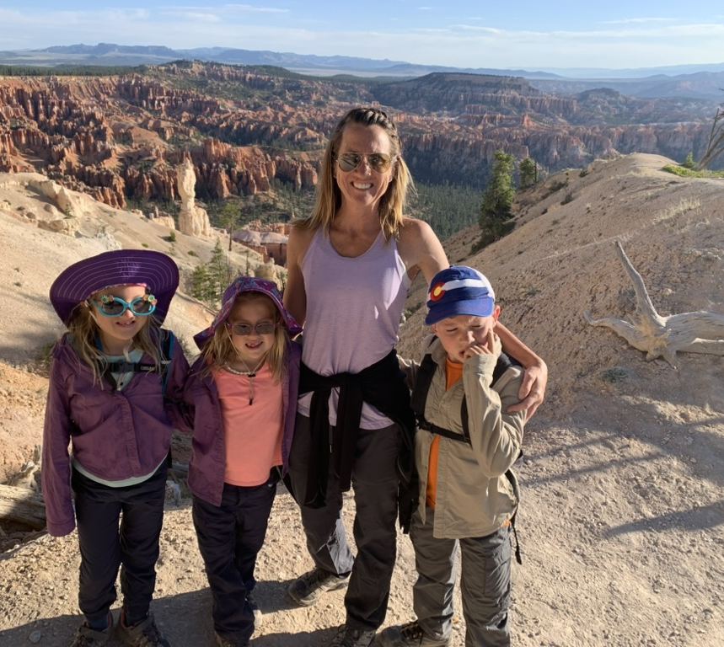

I am one of the lucky ones..

Slide 18

Resiliency
“Life is amazing, and then it is awful. And then it is amazing again. And in between the amazing and awful, its ordinary and mundane and routine. Breathe in the amazing, hold on through the awful and relax and exhale during the ordinary. That’s just living, heart-breaking, soul-healing, amazing, awful, ordinary life, and with all of this isn’t it breathtakingly beautiful?”
-L.R. Knost

