Slide 1
The Opioid Epidemic-Update and Impact in Workers’ Compensation
Gary M. Franklin, MD, MPH
Research Professor
Departments of Environmental Health,
Neurology, and Health Services
University of Washington
Medical Director, Washington state Dept of Labor and
Industries
Montana Governors’ Conference
Billings, MT. Oct 4, 2025

Slide 2
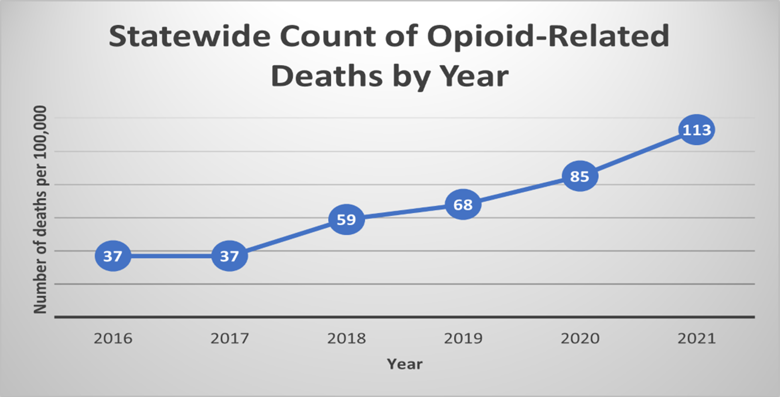
Report from Montana State University Extension Family and Consumer Sciences

Slide 3
CDC SUDORS* data for Montana 2023
Prescription opioid deaths-28
Fentanyl deaths=96
Methamphetamine-96
*State Unintentional Drug Overdose Reporting System

Slide 4
Opioid-Related Deaths,
Washington State Workers’ Compensation, 1992–2005
‘95
‘96
‘97
‘98
‘99
‘00
‘01
‘02
Year
Franklin GM, et al, Am J Ind Med 2005;48:91-9
Notes:
Within 1-2 years, however, unintentional deaths from opioids began to cross my desk in the WA workers compensation system. We then more systematically reviewed all deaths in our system, and published the first peer reviewed paper describing these deaths specifically related to prescribed opioids. These numbers are small because they occurred in the workers compensation population. At the same time, however, a similar trend involving fifty times as many deaths was occurring statewide.

Slide 5
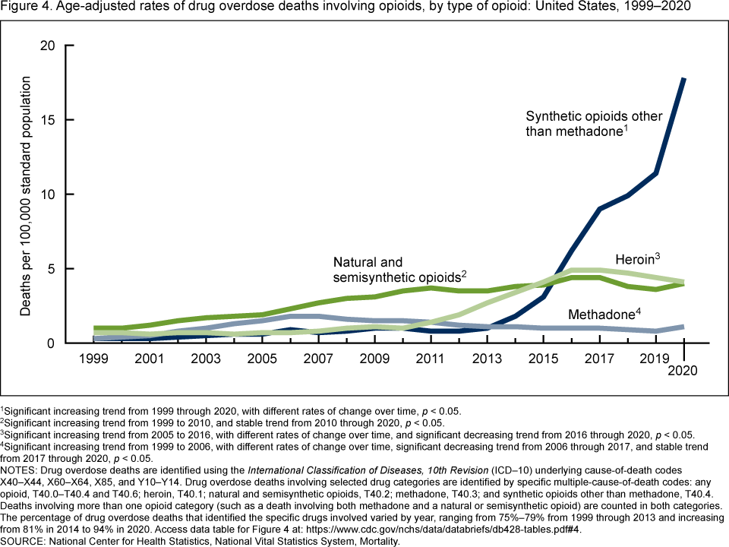

Slide 6
The Worst Man-made Epidemic in Modern Medical History
Over 1,000,000 deaths
Many more hundreds of thousands of overdose admissions
Millions addicted and/or dependent
Degenhardt et al Lancet Psychiatry 2015; 2: 314-22; POINT prospective cohort: DSM-5 opioid use disorder: 29.4%
Spillover effect to to SSDI*
*Franklin et al, Am J Ind Med 2015; 58: 245-51

Slide 7

These Were the Causes of the Epidemic
By the late 1990s, at least 20 states passed new laws, regulations, or policies moving from near prohibition of opioids to use without dosing guidance
WA law: “No disciplinary action will be taken against a practitioner based solely on the quantity and/or frequency of opioids prescribed.” (WAC 246-919-830, 12/1999)
Laws were based on weak science and good experience with cancer pain: Thus, no ceiling on dose and axiom to use more opioid if tolerance develops
WAC-Washington Administrative Code

Slide 8
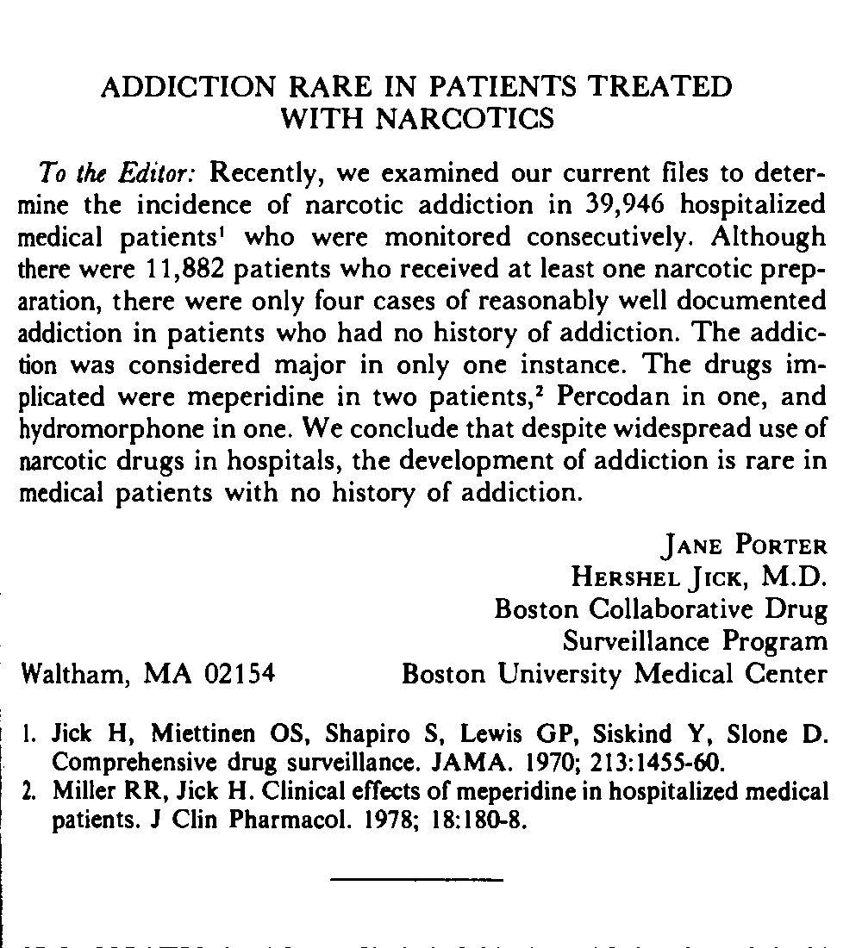
N Engl J Med. 1980;302:123.

Slide 9
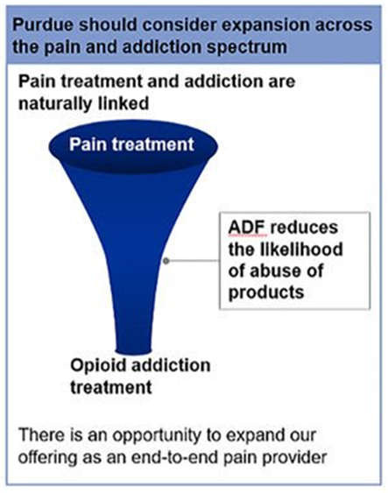
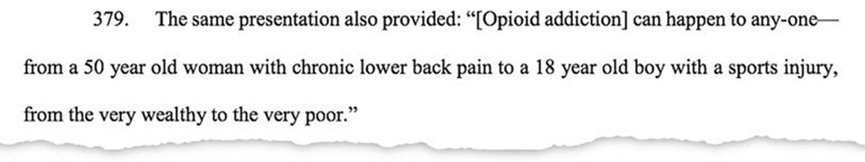
MUNDIPHARMA: PAIN MANAGEMENT MASTER CLASSES FOR 5000 AUSTRALIAN DOCS*
Purdue Project Tango-2014
From the NYT 4/1/19
Lawsuits lay bare Sackler family’s role in opioid crisis
*https://www.apnews.com/cfc86f47e03843849a89ab3fce44c73c

Slide 10
Krebs et al. SPACE randomized trial: JAMA 2018; 319: 872-82
Pragmatic trial opioid vs non-opioid meds over 12 months
Outcomes: pain-related function, pain intensity, and adverse effects
N=240 with mod/severe chronic LBP or hip/knee osteoarthritis despite analgesic use in MSP VA clinics
234/240 (97.5%) completed trial
Pain-related function no different at 12 months
Pain intensity better in non-opioid group
Adverse effects worse in opioid group
“Treatment with opioids was not superior to treatment with nonopioid medications for improving pain-related function over 12 months. Results do not support initiation of opioid therapy for moderate to severe chronic back pain or hip or knee osteoarthritis pain.”

Slide 11
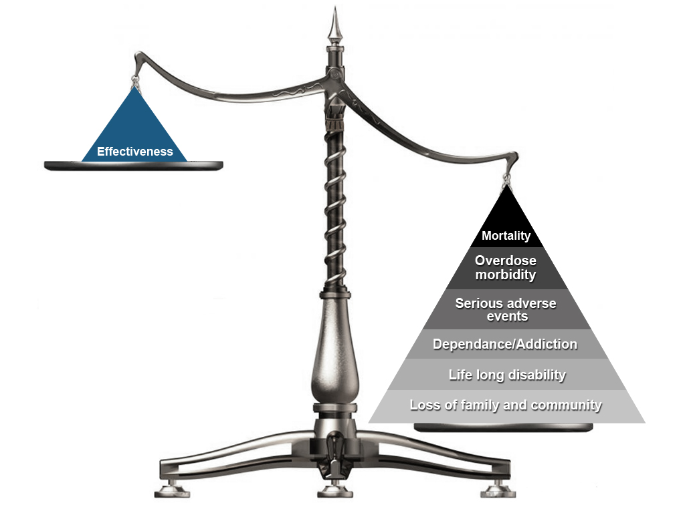
Risk/Benefit of Opioids for Chronic Non-Cancer Pain

Slide 12
CDC opioid guidelines-2016 vs 2022
Got rid of any dosing thresholds (50, 90 MED)
In place of specific yellow flag threshold doses, recommends should carefully evaluate individual benefits and risks
BUT THERE IS VERY LITTLE EVIDENCE THAT PRESCRIBERS CAN ADEQUATELY ASSESS RISK/BENEFIT TO ACCOMPLISH THIS RECOMMENDATION
Also deleted recommended days supply of the first opioid prescription

Slide 13
Continued Use by Initial Days of Opioid Therapy-Risk of use at one year increases by 1%/day starting with Day 3
Shah et al. MMWR 2017 Mar 17;66(10):265-9

Slide 14
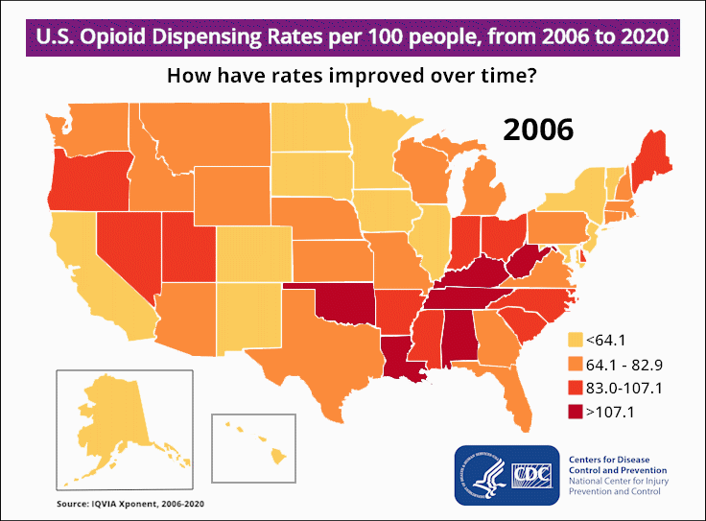

Slide 15
Ongoing Pressure to liberalize opioid prescribing once again
Washington State Medical Association-letter requesting adoption of 2022 CDC guidelines
Washington State Legislature-WA Legislature HB 1638-Enacting the Good Faith Pain Act-2025-2026-would prohibit actions against prescribers for inappropriate opioid prescribing
Washington Medical Commission-proposed new rules liberalizing opioid use once again-pushed by patient advocacy groups

Slide 16
FDA Requires Major Changes to Opioid Pain Medication Labeling to Emphasize Risks
Announced July 31, 2025
Changes follow a public advisory committee meeting in May that reviewed data showing serious risks—such as misuse, addiction, and both fatal and non-fatal overdoses—for patients who use opioids over long periods.
“The death of almost one million Americans during the opioid epidemic has been one of the cardinal failures of the public health establishment,” said FDA Commissioner Marty Makary, M.D., M.P.H. “This long-overdue labeling change is only part of what needs to be done — we also need to modernize our approval processes and post-market monitoring so that nothing like this ever happens again.”

Slide 17
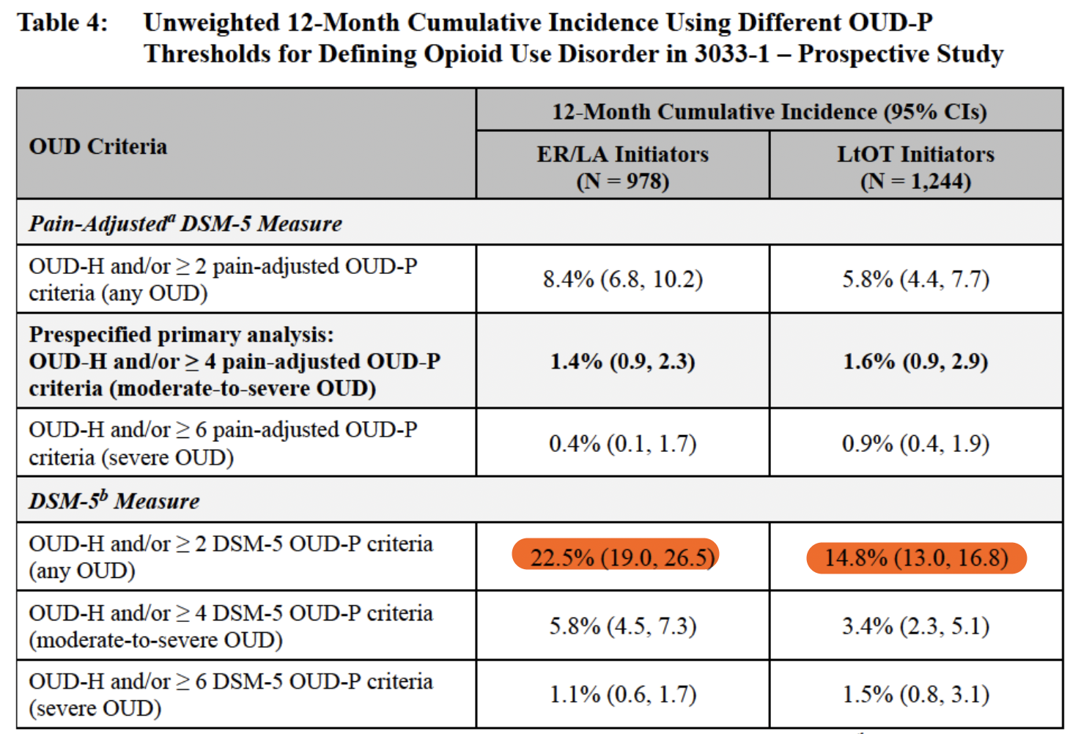
Source: Briefing Document for AADP and DSaRM Advisory Committees, May 5, 2025

Slide 18
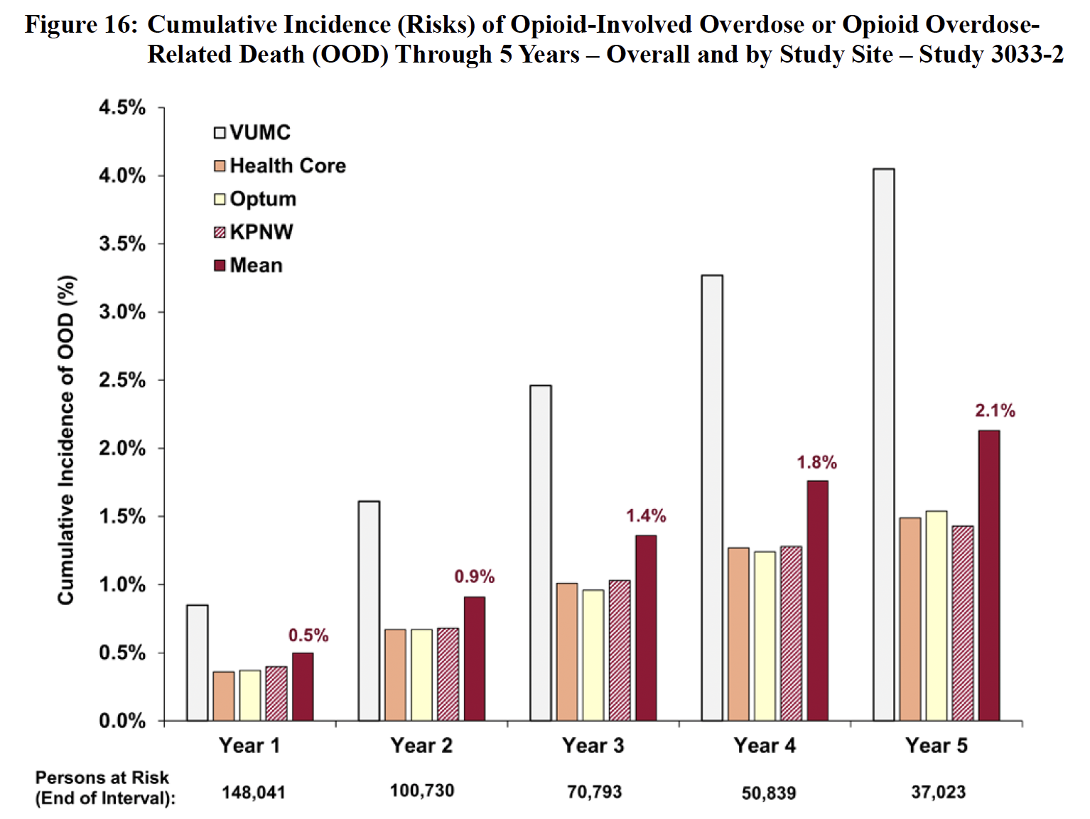
Source: Briefing Document for AADP and DSaRM Advisory Committees, May 5, 2025

Slide 19
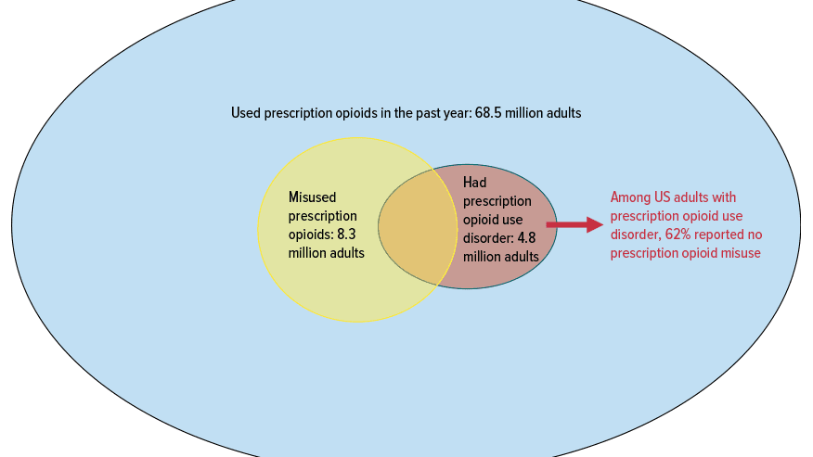
Han et al, J Clin Psychiat 2024; 85

Slide 20
Disability generated in workers’ compensation may be a public health problem of the highest order
1954-4% of men 25-54 unemployed
2010-20% of men 25-54 unemployed
Federal (SSD) disability-over 9 million-could be bankrupt in 7 years
Workers’ compensation is likely contributing a large proportion of the permanently unemployed/disabled to State, Federal and private disability programs
David Leonhardt, Men, Unemployment, and disability, NYT, 4/8/2011

Slide 21
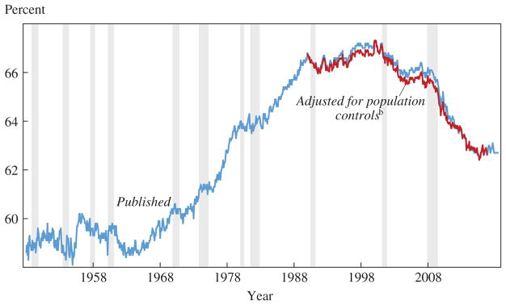
US Labor force participation rate-US Bureau of Labor Statistics

Slide 22
Early opioids and disability in WA WC. Spine 2008
Population-based, prospective cohort
N=1843 workers with acute low back injury and at least 4 days lost time
Baseline interview within 18 days(median)
14% on disability at one year
Receipt of opioids for > 7 days, at least 2 Rxs, or > 150 mg MED doubled risk of 1 year disability, after adjustment for pain, function, injury severity
Multiple studies have confirmed these findings

Slide 23
38% Increase since 2001

Slide 24
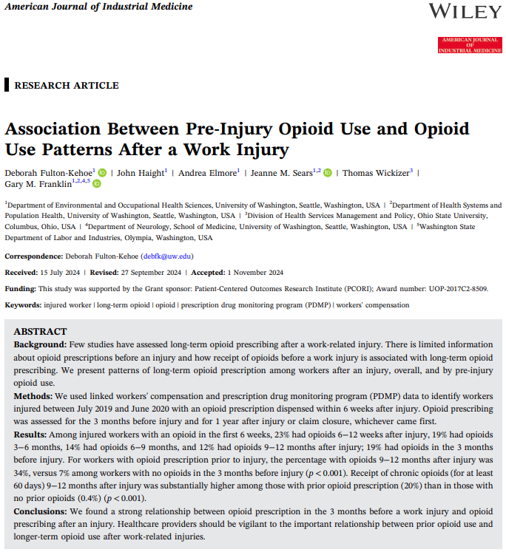
Reference
American Journal of Industrial Medicine Dec 5, 2024
Deborah Fulton-Kehoe, PhD, MPH
John Haight, MPH
Andrea Elmore, MS
Jeanne Sears, PhD
Thomas Wickizer, PhD
Gary Franklin, MD, MPH

Slide 25
Methods
July 1, 2019 – June 30, 2020 injuries
Accepted WA WC claims
Linked WC and PDMP to create cohort
Opioid in the first 6 weeks after injury in PDMP data
Used PDMP to assess subacute and chronic opioids
N=9899

Slide 26
Opioid time periods
Time period | Definition
Prior opioid | Opioid in 3 months before injury
Acute opioid | Opioid 0-6 weeks after injury
Subacute opioid | Opioid 6-12 weeks after injury
Longer-term opioid | Opioid 3 or more months after injury (3-6, 6-9, 9-12 months after injury)
Chronic opioid | At least 60 days of opioids in time period (3-6, 6-9, 9-12 months after injury)

Slide 27
Opioids before injury (prior opioids)
 | Number of workers | Percent
Acute opioid | 9,899
No prior opioid | 8,000 | 81%
Prior opioid | 1,899 | 19%
19% of injured workers had an opioid (based on PDMP) in the 3 months before injury

Slide 28
Opioids after injury

Slide 29
Does opioid use after an injury differ based on opioid use prior to injury?

Slide 30
Longer-term opioid use by prior opioid status
Longer-term opioid use was much higher among workers with prior opioid use
Among workers with no prior opioids, 7-10% had longer-term opioids versus 34-56% among those with prior opioids

Slide 31
Chronic opioid use (> 60 days) by prior opioid status
Chronic opioid use was much higher among workers with prior opioid use
Among workers with no prior opioids, only 0.4% had chronic opioids versus 20-29% among those with prior opioids

Slide 32
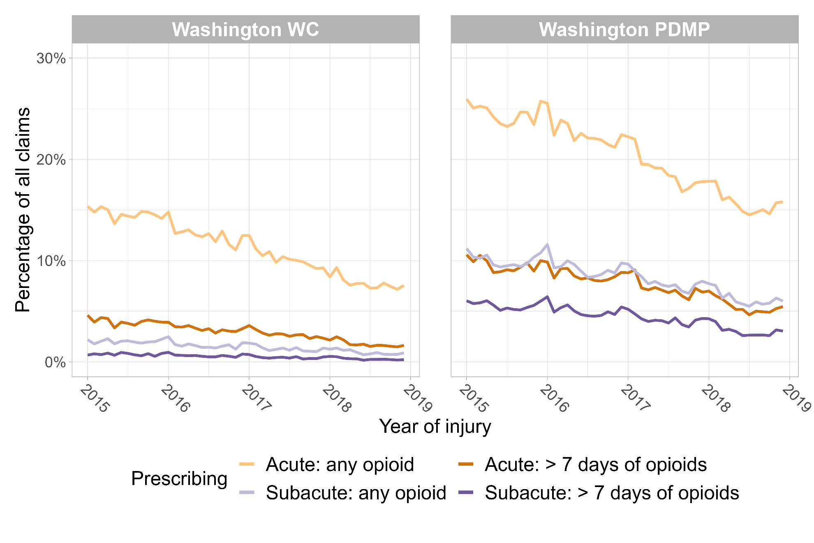
Comparison of WA WC and PDMP
Measures of acute and subacute prescribing are higher in PDMP than in WC

Slide 33
So what now Re injured workers on chronic opioids? Two main actionable targets
1. There are a lot of injured workers in our system who are on chronic opioids that we are not paying for-over 4000 such workers in WA in 2022
Many of these patients have been on chronic opioids for months/years, and most are likely dependent/OUD
These opioids ARE LIKELY affecting progress in your claim of record, including surgical outcomes
May not have ANY records on any of this unless the attending doctor checks the State’s PDMP
We have been conducting a pilot study to try to address these workers needs, including their chronic pain

Slide 34
COT patients present tremendous challenges
Physician burn-out and time constraints limit capacity to properly engage, fully assess, and determine best treatment path for the thousands of these patients in WA state
Many of these patients are in more rural counties with the least resources
Safety net clinics such as FQHC’s have been particularly hard hit-about 1/3 of the docs in a primary care national network reported having stopped initiating opioids altogether (Leverence et al, JABFM 2011; 24: 551-561)
AND Roger Rosenblatt’s UW student preceptees had very bad field experiences with these patients, so much so that many thought they would not go into primary care because of it

Slide 35
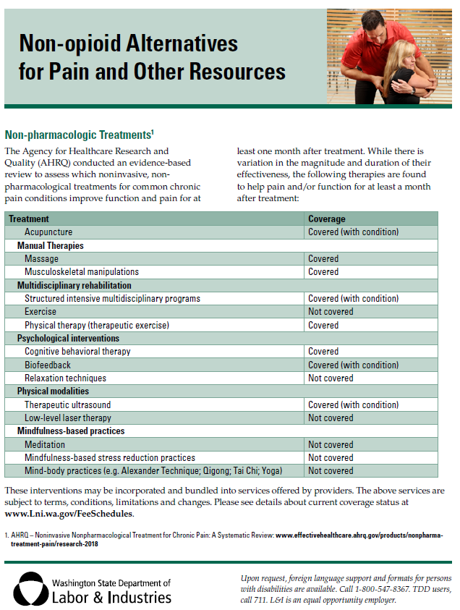
An ONC resource list by region with more details for
Non-opioid alternatives for pain
Pharmacologic alternatives
Drug and alcohol treatment programs
SIMP providers

Slide 36
Potential action #2
2. Is there any way to prevent workers who were on opioids pre-injury from transitioning to chronic opioids in the workers comp system?
Is the pre-injury opioid use or dependence or OUD a pre-existing condition that should not be covered?
How would you do surveillance for this scenario? If you know that a patient has received a first opioid prescription for an acute injury, reasonable to ask the prescriber to check the state PDMP for prior/concomitant use. If prior use, and especially if prior chronic use (at least 60 days in the quarter prior to injury), suggest alternative pain treatments such as Tylenol/NSAID combos and stop workers comp covered prescription opioids

Slide 37
Table 1. Duration of Opioid Treatment for Postoperative Discharge
Type I
Dental procedures such as third molar or wisdom tooth extraction, graft, implant | Prescribe a nonsteroidal anti-inflammatory drug (NSAID) or combination of NSAID and acetaminophen for mild to moderate pain as first line therapy If opioids are necessary, prescribe ≤ 3 days (e.g., 8 to 12 pills) of short-acting opioids in combination with an NSAID or acetaminophen for severe pain
Procedures such as hernia repair, laparoscopic appendectomy, carpal tunnel release, laparoscopic cholecystectomy, biopsy, meniscectomy | Prescribe non-opioid analgesics (e.g., NSAIDs, acetaminophen) and non-pharmacologic therapies as first line therapy If opioids are necessary, prescribe ≤ 3 days (e.g., 8 to 12 pills) of short-acting opioids for severe pain
Type II
Procedures such as anterior cruciate ligament (ACL) repair, rotator cuff repair, discectomy, laminectomy | Prescribe non-opioid analgesics (e.g., NSAIDs, acetaminophen) and non-pharmacologic therapies as first line therapy Prescribe ≤ 7 days (e.g., up to 42 pills) of short-acting opioids for severe pain. For those exceptional cases that warrant more than 7 days of opioid treatment, the surgeon should re-evaluate the patient before refilling opioids and taper off opioids within 6 weeks after surgery
Type III
Procedures such as lumbar fusion, knee replacement, hip replacement | Prescribe non-opioid analgesics (e.g., NSAIDs, acetaminophen) and non-pharmacologic therapies as first line therapy Prescribe ≤14 days of short-acting opioids for severe pain. For those exceptional cases that warrant more than 14 days of opioid treatment, the surgeon should re-evaluate the patient before refilling opioids and taper off opioids within 6 weeks after surgery
Patients on Chronic Opioid Therapy
Elective surgery in patients on chronic opioid therapy | Follow the recommendations above for the appropriate surgery type Resume chronic regimen if patients are expected to continue postoperatively

Slide 38
Specific steps to take
Dramatic reduction of acute opioid prescribing for young adults and teens after wisdom tooth extraction-use combo of Tylenol and NSAIDs instead
Limit acute prescribing of opioids after surgery and injuries to 3 days in most cases, 7 days for more severe situations
Don’t get started on chronic opioid therapy for routine musculoskeletal conditions
For patients on chronic opioids for pain (>90 days), offer alternative pain treatments and be watchful for dependence/opioid use disorder-offer medication assisted treatment with buprenorphine
Coordinate care for all patients admitted for prescription opioid related overdose; use pharmacists on teams
Encourage universal use of the State prescription drug program for all prescribers

Slide 39
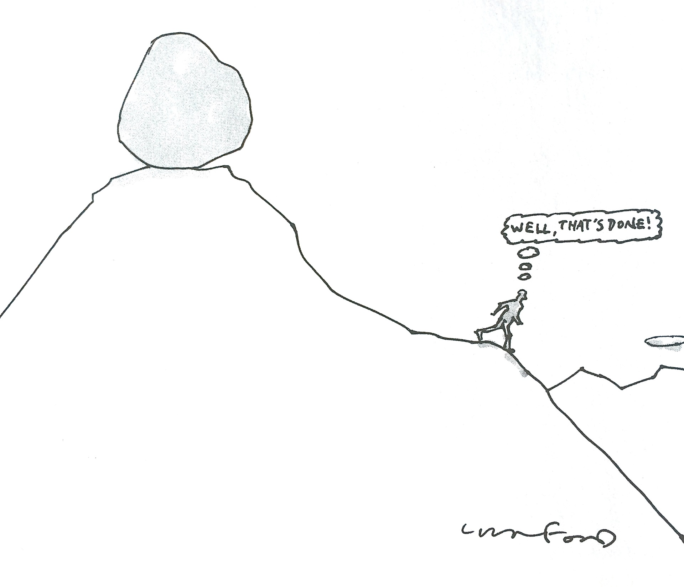

Slide 40
Questions? And requests for these slides
meddir@uw.edu

