Slide 1

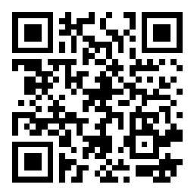
City of Los Angeles Workers’ Compensation Program and Strategies
join at slido.com with #3606098
Dr. Tyrone Spears
Chief Risk Officer

Slide 2


Name one word to describe Workers' Compensation!
ⓘ Start presenting to display the poll results on this slide.

Slide 3
City of Los Angeles Program Overview
Self-Insured
Self Administration and Third-Party Administration
Full-Service City with over 45,000 employees
No Insurance or Excess Coverages
Alternative Dispute Resolution Programs
35 Operating Departments – Police, Fire, Airport, Port, Zoo, etc

Slide 4

Audience Poll

Slide 5

How many open Workers' Compensation Claims does the City of LA have?
ⓘ Start presenting to display the poll results on this slide.

Slide 6
How Much Do We Spend on Worker’s Compensation?
Total Annual Budget
Total Indemnity Benefits Paid
Total Medical Paid
Cost Containment Programs

Slide 7
Advocacy Model – Employee Centric
Employee Advocacy Claims Model
Ombudsman/ Member Advocates
Enhanced and Expedited Utilization Review Process – Increased Adjuster Approval List
On Staff Nurses to Assist with Medical Treatment Decisions/Options
Soft Landing for All Delay and Denial of Benefits
Leading with Empathy
Expansive Training on Understanding Other People
Empathy is Not Sympathy
Starts with the Leadership Team

Slide 8

Return To Work Strategies

Slide 9

Return To Work or Attend Game Show?

Slide 10
Audience Poll

Slide 11
What are the challenges with getting employees to return to work?
ⓘ Start presenting to display the poll results on this slide.

Slide 12
Three C’s of Return To Work
Communication
Collaboration
Compassion

Slide 13
Stay At Work - SAW
Goal of SAW: To keep an injured temporarily impaired worker on the job, if medically feasible.
Employees who have a temporary impairment that does not necessitate time away from the worksite may need accommodations in order to stay at work.
Employers/Claims Professional
Should involve the physician throughout the process
Have customized forms to ensure work restrictions are clear and meaningful
Should involve the employee throughout the entire process
New position is not needed

Slide 14
Benefits of SAW
Reduce number of lost workdays
Maintain workforce productivity
Lower risk of condition becoming long-term or permanent disabled
Reduce WC costs

Slide 15
Return To Work Program – RTW
Goal of RTW: To return an injured temporarily impaired worker to the workplace as soon as medically feasible.
Employees who have been on leave (FMLA, STD/LTD, ADA, Workers Compensation, etc.) may need accommodations in order to return to work.
Employers/Claims Professional
Need clear medical documentation of work restrictions and limitation.
Restrictions should be bio-mechanical restrictions
Require doctors to address RTW at every appointment.
Should involve the employee throughout the entire process
Should avoid any “100% restriction-free” policies
Avoid any ADA violations

Slide 16
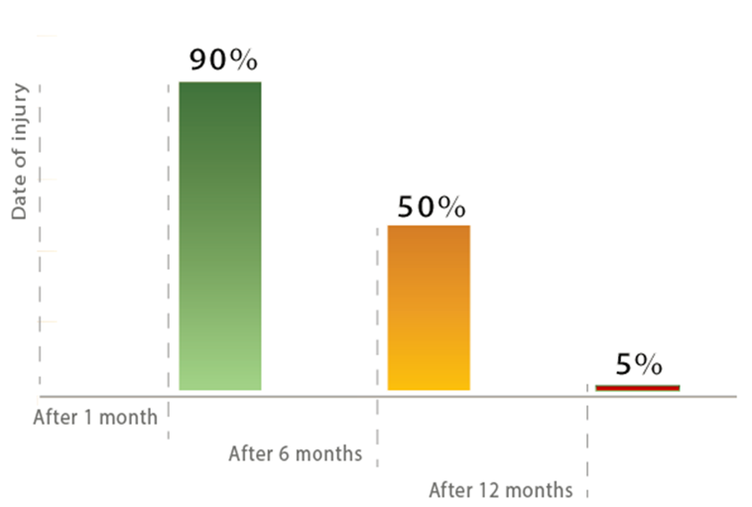
Bureau of Labor Statistics reports that the likelihood of an injured employee returning to work decreases from 90% during the first month, to just 50% after 6 months. After a year, the likelihood drops down to 5%.

Slide 17

Barriers to Return To Work
Aging work force – changing work environment
People are living longer (notwithstanding the opioid epidemic impact)
The aging workforce is working longer due to a lack of retirement resources
Average retirement savings is $45,000
More comorbidities in older workforce create obstacles to returning to work
People are working longer work hours, multiple jobs
Loss of job security, medical coverage - union protection – less tenure, attachment
Notes:
Microsoft 365 stock photo. Assuming all presenters are Microsoft 365 subscribers, we have access to the full library of creative content.

Slide 18


Barriers to Return To Work
Factors hindering return to work (injured employee)
Economic (reduced income for employee)
Psychosocial issues (childcare, parents, commute)
Lack of employee-employer relationship
Concern about re-injury (employee, employer)
Lack of accurate or clear instructions from the doctor
Compliance with work restrictions
Employee wanting to exceed work restrictions
Perceived pressure from co-workers to exceed restrictions

Slide 19

Barriers to Return To Work
Factors hindering modified duties or transitional return work (employer)
Economic incentives not aligned to encourage employers to provide light duties
No financial incentives for front-line management to provide or manage transitional return-to-work programs
No job which can accommodate light duties
No clear job description for doctor to use which defines current physical job duties and requirements
Punitive return-to-work programs (make work sorting plastic paper clips)

Slide 20

Return-to-work Negotiation Best Practices
Methods to reduce lost time (employer and examiner)
Show care and concern
Be empathic – put yourself in their shoes
Get the employee prompt medical care if needed
Help them select a medical provider
Provide physician's form, pamphlet, and pharmacy information
Investigate the accident
Complete forms and report claim
Offer light duty
Avoid the disconnect
Care calls, cards
Invite them to visit
Keep them engaged
Notes:
Microsoft 365 stock photo. Assuming all presenters are Microsoft 365 subscribers, we have access to the full library of creative content.

Slide 21

Return-to-work Negotiation Best Practices
Methods to reduce lost time (employer and examiner)
Build a relationship with your medical providers
Tour the facility
Explain your light-duty program
Discuss expectations
What does the employer want
What does the injured employee want
What does the doctor want
The right care, at the right time, with the right provider for the right outcomes
Notes:
Microsoft 365 stock photo. Assuming all presenters are Microsoft 365 subscribers, we have access to the full library of creative content.

Slide 22
City of Los Angeles SAW/RTW Strategies
Ergonomic Sit/Stand Stations Embedded in Departments
Specialized Form for Primary Doctor to Complete
Supplemental RTW Report from Med-Legal Providers
Citywide Light Duty Program
Job Analysis Bank
RTW Checklist for Supervisors
Returning To Work Roadmap for Employees

Slide 23
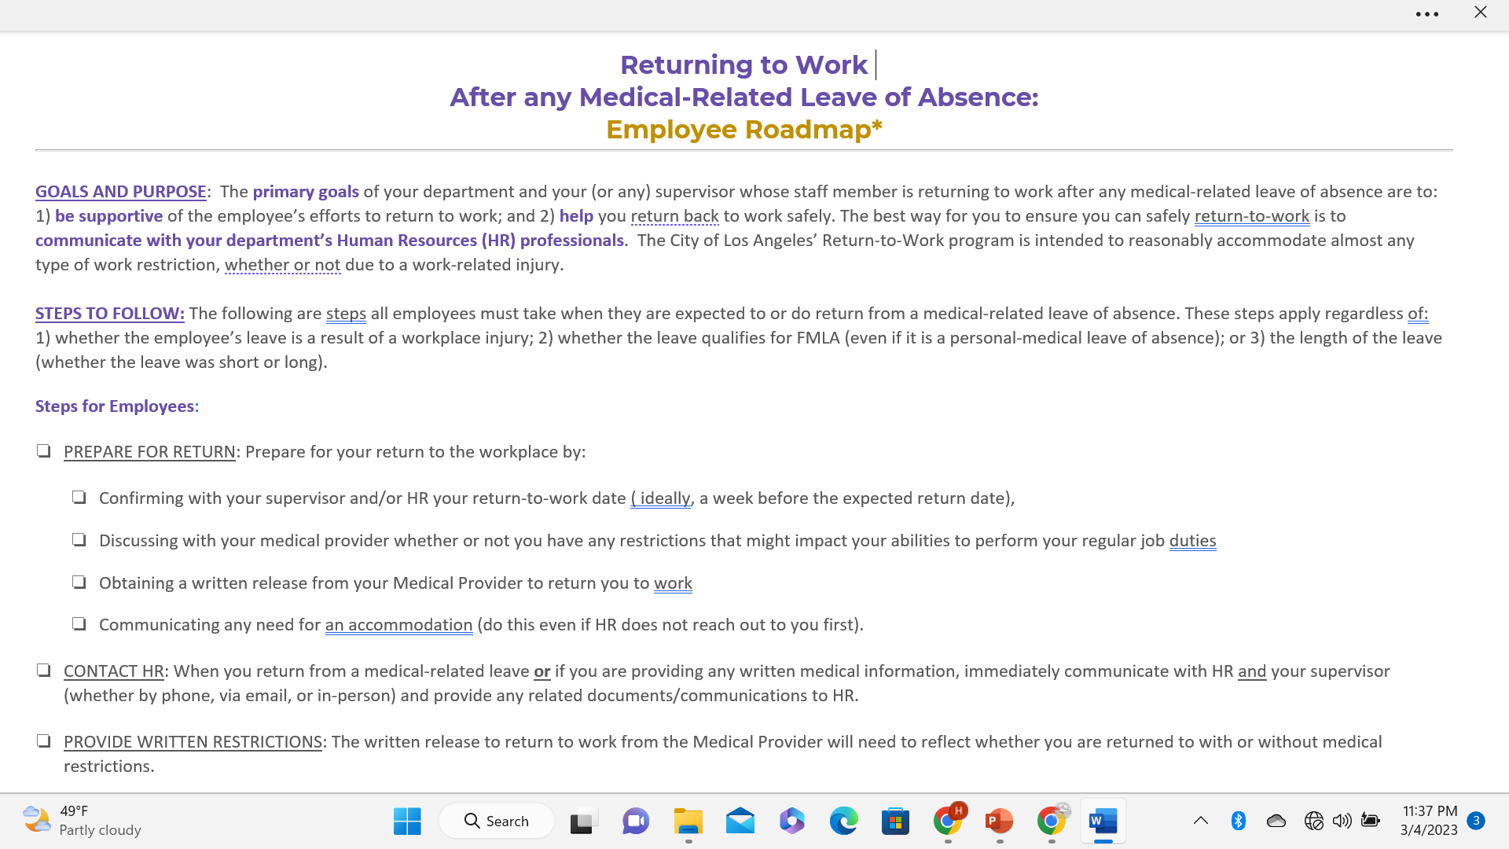
Employee Roadmap Sample

Slide 24
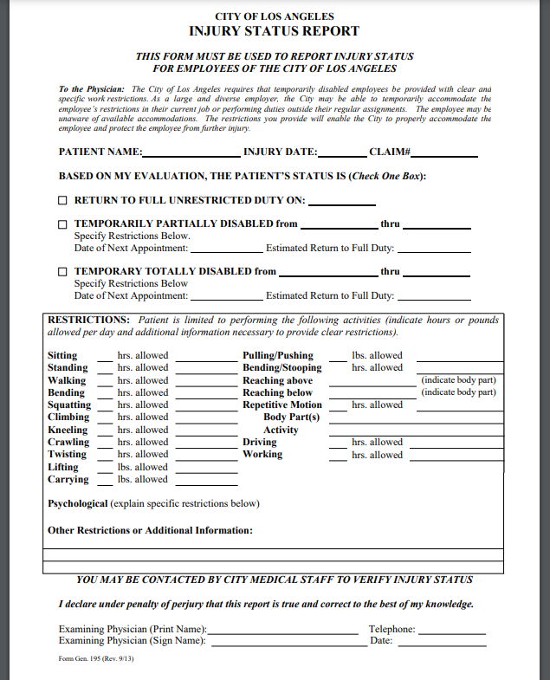
Specialized Work Status Form

Slide 25

Questions

Slide 26

Thank You
Dr. Tyrone Spears
City of Los Angeles
Chief Risk Officer
Tyrone.Spears@lacity.org
213-473-3378

