Slide 1

Notes:
Kids Chance of MT formed as a non-profit in 2017 with a Mission to provide scholarships and support to children of MT workers who have been seriously injured or killed on the job.
Kids’ Chance of Montana is one of 50 independent state Kids’ Chance organizations networked to achieve more, together, through Kids’ Chance of America.
KCMT has an all-Montana, all-volunteer Board of Directors who work diligently to help impacted Montana kids a chance to pursue their higher

Slide 2

Kids’ Chance of Montana Board
Trevin Anderson, Northwestern Energy
Leslie Dalpiaz, Dalpiaz Law
Vicki Evans, MT Contractor Compensation Fund
Ethan Heverly, MT State Fund
Casey Kyler-West, St. Peter’s Health
Mike Marsh, Midland Claims
Carissa Stahly, MT Dpt. Labor & Industry
Leah Tietz, Retired (MUS Self-Funded)
Danielle Vukonich, Ritsema Law
Rob Virts, MT DOA Work Comp Mgt. Bureau
* Jessica Jones, of MT Public Employee Retirement Admin rotated of the Board this morning after serving admirably as our Board Treasurer

Slide 3
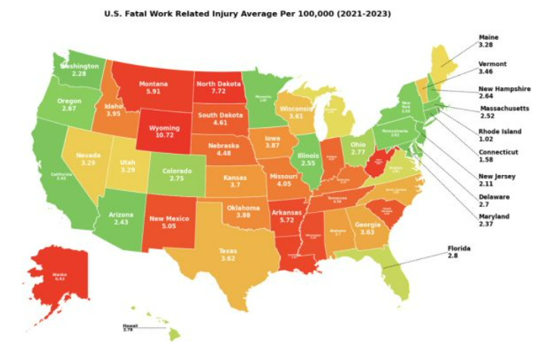
MT Work Fatality Rate (2021-23)
Notes:
According to BLS, A U.S. worker died every 99 minutes from a work-related injury in 2023 compared to 96 minutes in 2022.Occ. Injuries.
MAP: US Fatal Work Injury Avg. Per 100,000 workers 3 years 2021-23.
2021 -23
WY 10.72/100K (most dangerous place to work, 184% above nat’l average of 3.77;
ND 7.72/100K; avg. of 32.3 fatalities over 3 year pd. 37 in 2022
ALASKA 6.42/100.
WV 6.01/100
MT 5.91/100 avg. 34.3 with 2021 at 40 being highest.
Kids’ Chance of MT supports kids pursuing post-high school education and vocational training through age 26.
In MT ≈ majority are in age groups likely to have children still eligible for a KCMT scholarship(<67y.o.
MT 5.91/100,000 workers

Slide 4
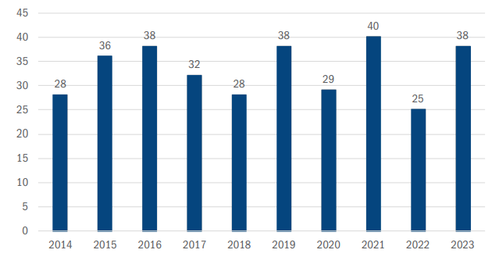
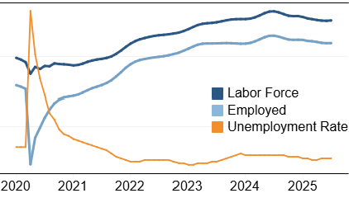
MT Work Fatality - 2023
Notes:
MT DLI 2023 CFOI Report – Thank you Peggy Coggeshall and Donetta McDowell.
Census Fatal Occ Inju.
According to BLS, A U.S. worker died every 99 minutes from a work-related injury in 2023 compared to 96 minutes in 2022.Occ. Injuries.

Slide 5
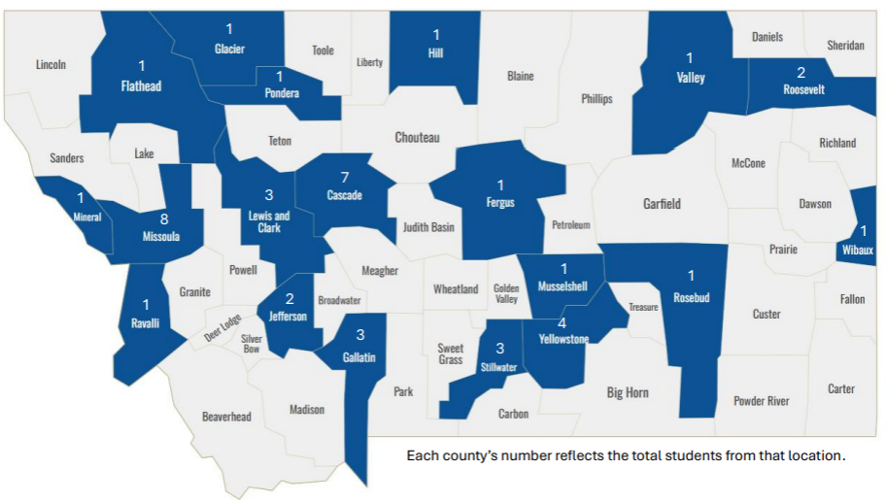
Students’ Home Counties 2018-25

Slide 6

Planning for the Future (PFF)
kidschance.org/pff-for-families

Slide 7
Building on Success

Slide 8
State Employee Charitable Giving
SECGC 2025 for giving year 2026
Easy Planned Giving with Payroll Deduction
Potential to Win prizes by participating
Campaign Kickoff in Capitol Rotunda 9/25
Sign-up between Sept 22 - Oct 17 to give

Slide 9
Grateful for our Supporters!
Special Partners: Montana State Fund
Dennis & Phyllis Washington Foundation
ALPS Corp
AASCIF
Blue Cross Blue Shield of MT
Browning Kaleczyc Berry & Hoven
Clark Fork Law Offices, PC
Crowley Fleck PLLP
Dalpiaz & Associates
D.A. Davidson
Dick Anderson Construction, Inc
Employers
Equian
Fair Claim Work Comp Attorneys
First Interstate Bank
Glacier Bankcorp.
Groves & Toennis
Harnish Group, Inc
Helena Community Foundation
Intermountain Claims
McKenna & Starin Law
Midland Claims Service
Miller Tourlotte Law, PLLC
Missoula Bone & Joint
Montana Contractors Association
MT Contractor Compensation Fund
Montana Rail Link
Mountain West Holdings
Murphy Law Firm
NCCI
NorthShore Risk Consulting, LLC
Northwestern Energy
Odegaard Injury Lawyers
PACBLU
PayneWest
Planned & Engineered Construction
Potts Law, PLLC
REOH
SECGC (state employees)
Sparrow Enterprises, Inc
Sullivan Financial
Thomas Parkhill
Treasure States Occ Health/MMI
Valley Bank of Helena
Victory Insurance
WellCare
And generous individuals from across the State!

Slide 10
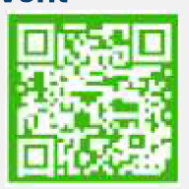
THANK YOU
Share
Donate
Volunteer
!
PO Box 7224, Helena, MT 59604
info@kidschanceofmontana.org

